Slide 1


STRATEGIES FOR MOVIE SUCCESS
An analysis of movie related data from 1980-2001
By Anuli Nzewi

Slide 2


ABOUT ME
Name: Anuli Nzewi
Email: anulichinenye@gmail.com
Circle Number: 1a

Slide 3

INTRODUCTION AND DATASET DESCRIPTION
This analysis seeks to uncover the factors that contribute to the success of movies using movie-related dataset spanning the years 1980 to 2001 in order to help investors and production companies make informed decisions and mitigate risk.
The dataset includes information such as the movie name, budget, gross, directors, stars and production companies.

Slide 4
DATA QUESTIONS
How many movies were made in total?
What are the most profitable countries?
What are the top 5 highest-grossing movies?
Who are the top 5 highest-grossing actors?
Who are the top 7 highest-grossing directors?
What are the most profitable genres?
What is the yearly percentage Return on Investment?

Slide 5



DATA CLEANING
The filter tool in Excel was used to identify and eliminate incomplete information regarding the budget and gross revenue of the movies. This step was crucial in ensuring the validity and reliability of my analysis.
No duplicates were found, the 'country' column was standardized to maintain consistency throughout the dataset.

Slide 6


DATA WRANGLING
The file was obtained in CSV format and subsequently converted to XLSX format using a third-party converter tool (cloud convert).
Pivot tables were utilized to extract valuable insights from the data, and graphs were employed to visually represent these insights.

Slide 7

ANALYSIS
&
RECOMMENDATIONS

Slide 8
TOP 7 HIGHEST GROSSING DIRECTORS
Total Budget
Total Gross
$6B
The top 7 directors accounted for over 15% of the $147.50 billion that was made in the 21-year period.
Spielberg and Cameron top the list with gross earnings of $5.22 billion and $3.40 billion, driven by the success of Jurassic Park and Avatar, respectively.
The dataset includes directors from varied genres and styles. Their filmographies demonstrate versatility and potential for further expansion.
$4B
$2B
$0B
S. Spielberg
J. Cameron
R. Zemeckis
C. Columbus
R. Howard
R. Emmerich
I. Reitman

Slide 9
RETURN ON INVESTMENT (ROI)
300%
The ROI fluctuates through out the analysed period which shows a change in the financial landscape of the movie industry .
The higher ROI in earlier years like 1980 and 1982 (283% and 223%) indicates that there were highly successful movies and potentially lesser competition.
In later years, the ROI is relatively lower when compared to earlier years. This could be due to increasing production budget, higher marketing cost and a more competitive movie landscape.
200%
100%
0%
1980
1981
1982
1983
1984
1985
1986
1987
1988
1989
1990
1991
1992
1993
1994
1995
1996
1997
1998
1999
2000
2001

Slide 10
TOP 5 HIGHEST GROSSING ACTORS
Bruce Willis
Tom Hanks is the highest-grossing actor, with a total earning of $4.48 billion. Bruce Willis, Harrison Ford, Mel Gibson, and Tom Cruise have all grossed between $3.29 billion and $3.42 billion.
Just like the directors, the highest grossing actors have a diverse filmography ranging from action to family and horror.
Their continued success makes them highly valuable as investors , directors and production companies are assured of success if they star in their movies.
Harrison Ford
Mel Gibson
Tom Cruise
Tom Hanks
$0B
$1B
$2B
$3B
$4B
$5B

Slide 11
Total Budget
Total Gross
BUDGET AND GROSS BY GENRE
$60B
Action movies have the highest total gross of $52.39 billion, followed closely by comedy movies with $34.64 billion.
Drama movies and animation grossed a sustantial amount with $21.31 billion and 10.62 billion respectively.
As seen in the line chart, the higher the production budget, the higher the gross revenue and vice versa.This indicate a positive relationship between the total budget and total gross by genre.
$40B
$20B
$0B
Action
Crime
Drama
Family
Horror
Sci-Fi
Comedy
Fantasy
Mystery
Thriller
Biography
Romance
Western
Animation
Adventure

Slide 12
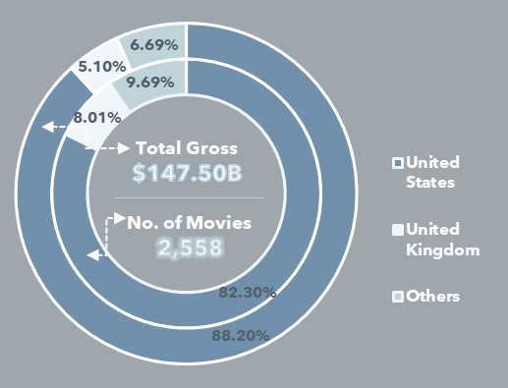
MOVIE COUNT & GROSS BY COUNTRY
The United states dominates the movie industry accounting for 82.30% of total movies produced and 88.2% of total gross revenue.
The United Kingdom plays a noteworthy role in movie production (8.01%) but generates a lower percentage of total gross revenue(5.1%).
The "Others" category consists of 31 countries excluding US and UK whose contributions are too small to visualize individually. Their overall impact in terms of movie count and gross revenue is significantly lower.

Slide 13

TOP 5 HIGHEST GROSSING MOVIES
The top 5 highest grossing movies all did over $1 billion each, with "Titanic" ranking as the highest-grossing movie at $2.20 billion.
The movies above represent a diverse range of genres varying from drama to animation, which demonstrates that movies from any genres have the potential to achieve significant financial success if they resonate with audiences effectively.
Franchise-based movies like "Harry Potter," "Star Wars," and "Jurassic Park" demonstrate the enduring appeal and financial success of well-known franchises.

Slide 14
DIVERSIFY INVESTMENT
Allocate resources across different genres, target audiences and budget ranges in order to reduce risks and improve the chances of profitabilty.
Explore untapped/niche genres of movies and tailor marketing and storytelling that appeals to aspecific target audience.
Analyse the relationship between movie budgets and gross earnings across different genres in order to optimize budget allocation and maximize return on investment.
RECOMMENDATION
MARKET EXPANSION
Given the global nature of the movie industry, consider partnerships with production companies and talent agencies in the "other" countries. It will help navigate local market and enhance market reach in order to expand global market.
Capitalize on the US market while exploring growth oppurtunity in the UK. This can be done by producing tailor made content for the US and the UK.

Slide 15
CAPITALIZE ON STAR POWER AND RENOWNED DIRECTORS
Capitalize on the star power of actors who have a proven track record of box office success and connecting with global audience.
Leverage the top directors' unique styles and storytelling approaches by applying their styles in other genres of movies in order to increase profitability.
Identify and nurture upcoming actors and directors who have the potential of connecting with the global audience. This can lead to long term success.
RECOMMENDATION

Slide 16

THANK YOU

